Slide 1


Slide 2
The Electric Field Due to a Line of Charge
We now consider charge distributions that consist of a great many closely spaced point charges (perhaps billions) that are spread along a line, over a surface, or within a volume.
Such distributions are said to be continuous rather than discrete.

Slide 3
The Electric Field Due to a Line of Charge
Since these distributions can include an enormous number of point charges,
we find the electric fields that they produce by means of calculus rather than by considering the point charges one by one

Slide 4
The Electric Field Due to a Line of Charge
When dealing with continuous charge distributions, it is most convenient to express the charge on an object as a charge density rather than as a total charge.
charge density: charge per unit length
SI unit is the coulomb per meter

Slide 5
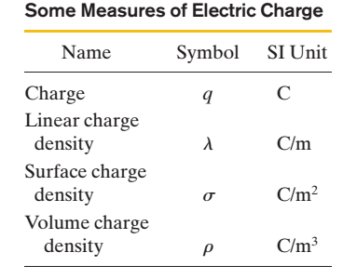
Some measure of Electric Charge

Slide 6
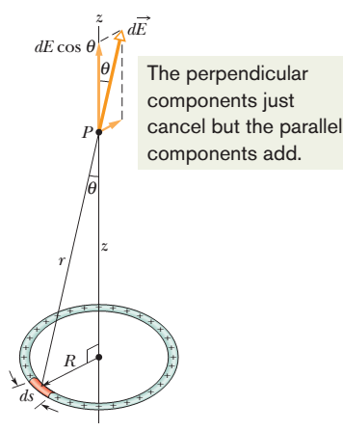
The Electric Field Due to a Line of Charge
A thin ring of radius R with a uniform positive linear charge density l around its circumference.
What is the electric field at point P, a distance z from the plane of the ring along its central axis?

Slide 7



For Z=0. At that point, E=0. This is a reasonable result because if we were to place a test charge at the center of the ring, there would be no net electrostatic force acting on it; the force due to any element of the ring would be canceled by the force due to the element on the opposite side of the ring. If the force at the center of the ring were zero, the electric field there would also have to be zero.

Slide 8
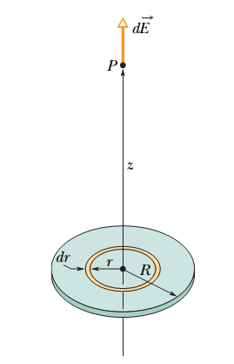



The E Field Due to a Charged Disk
If we let R→∞ while keeping z finite, the second term in the parentheses in above eq. approaches zero, and this equation reduces to

Slide 9
The Electric Field Due to a Line of Charge
Problem
(a) A charge "300e is uniformly distributed along a circular arc of radius 4.00 cm, which subtends an angle of 40°. What is the linear charge density along the arc?

Slide 10
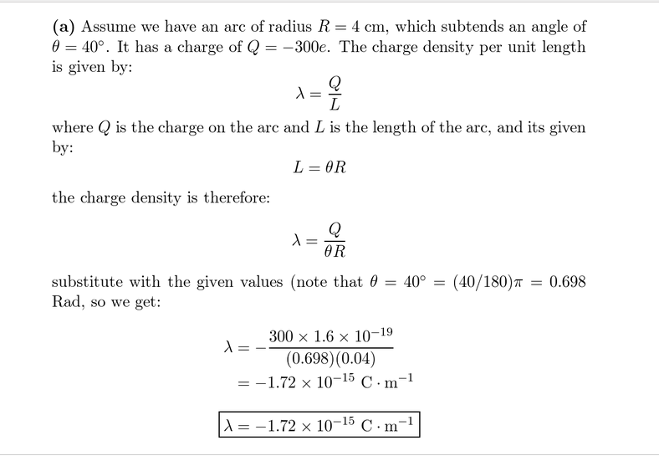
Solution

Slide 11
The E Field Due to a Line of Charge
(b) A charge "300e is uniformly distributed over one face of a circular disk of radius 2.00 cm. What is the surface charge density over that face?

Slide 12
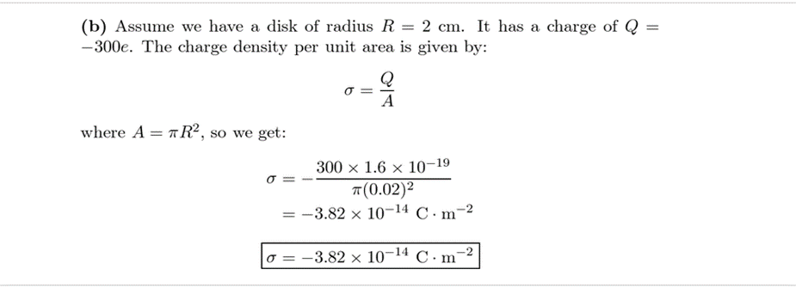
The E Field Due to a Line of Charge

Slide 13

(c) A charge "300e is uniformly distributed over the surface of a sphere of radius 2.00 cm. What is the surface charge density over that surface?

Slide 14
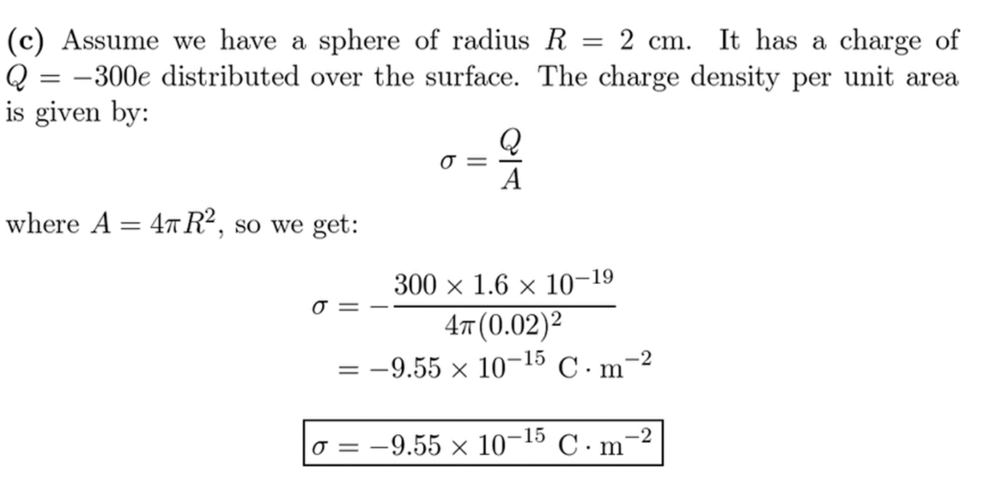
Solution

Slide 15

(d) A charge "300e is uniformly spread through the volume of a sphere of radius 2.00 cm. What is the volume charge density in that sphere?

Slide 16
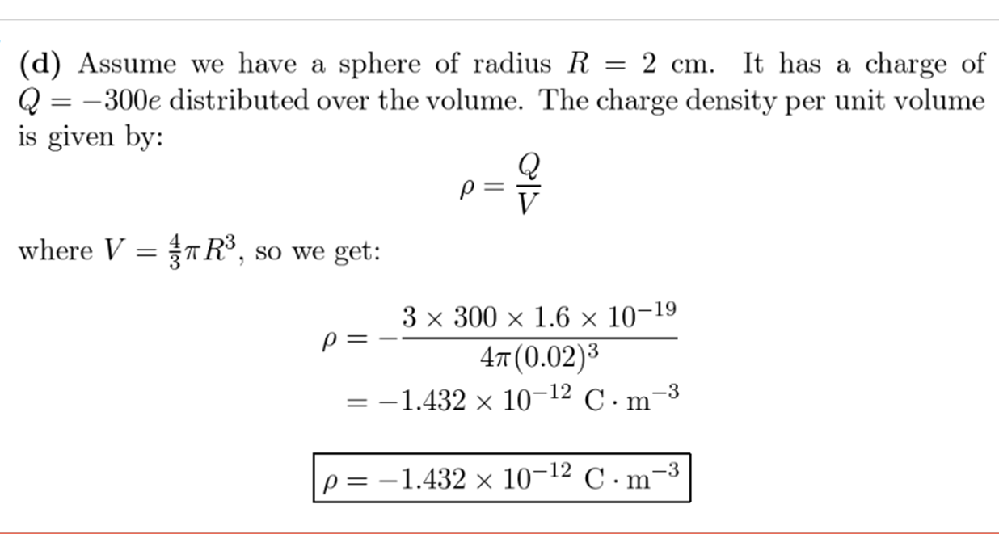

Slide 17
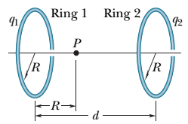
Figure shows two parallel non conducting rings with their central axes along a common line.
Ring 1 has uniform charge q1 and radius R; ring 2 has uniform charge q2 and the same charge and radius R. The rings are separated by distance d=3.00R. The net electric field at point P on the common line, at distance R from ring 1, is zero. What is the ratio q1/q2?

Slide 18
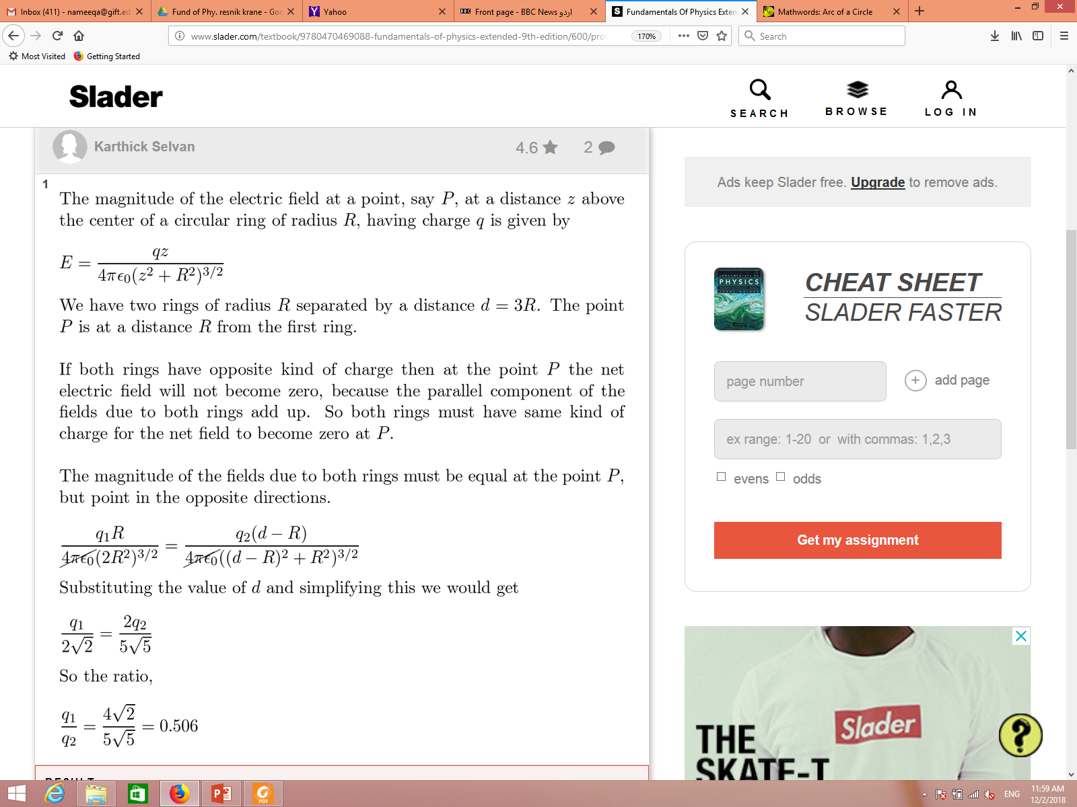
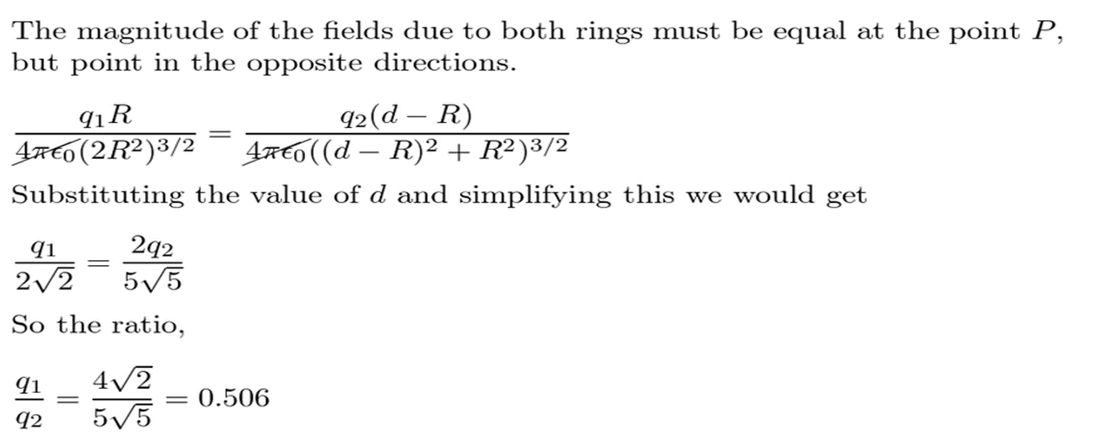

Slide 19

Force on a Point Charge in an Electric Field
When a point charge q is placed in an external electric field , the electrostatic force that acts on the point charge is
Force has the same direction as if q is positive and the opposite direction if q is negative.

Slide 20


Dipole in an Electric Field
When an electric dipole of dipole moment is placed in an electric field, the field exerts a torque on the dipole:
The dipole has a potential energy U associated with its orientation in the field

